Slide 1
RETROSPECTIVES AGENDA
After we’ve done something, naturally, we know so much more. We can discover decisions and actions we wish we could do over.

Slide 2
The 12th agile principle states:
At regular intervals, the team reflects on how to become more effective, then tunes and adjusts its behaviour accordingly

Slide 3
Purpose
The purpose of the retrospective is to:
Inspect and reflect, in order to understand what happened.
Then analyse, adjust, and adapt, in order to learn and improve.
Notes:
“Special meeting that takes place at the end of a period of work – usually an iteration or software release. In a retrospective, a team steps back, examines the way they work, analyses and identifies ways they can improve” Esther Derby
At the end of a project, everyone knows so much more. Naturally, we will discover decisions and actions we wish we could do over. This is wisdom to be celebrated, not judgment used to embarrass
Promoting a culture of continuous improvement and insight
Create a set of lessons learnt
Create a feedback loop in the process
Harness our insights and applying those lessons to future work

Slide 4
Retrospective PROOF
Past What happened during the iteration? (Events)
Results What was achieved/not achieved during the iteration?
Obstacles What got in the way?
Outlook What still needs to be done?
Feelings How does you feel about the iteration?
Concept by Jonathan Bach (@jbtestpilot) 2000, Modified by Mike Burns 2020
Notes:
Remember we need proof that the retro is valuable, a lot of our perception about the iteration is based on feelings. If we finished the goal we feel good, even if it was hard. If we don’t finish all the work and that becomes a trend we start to feel bad. Use the feelings to guide towards the good feelings – when we feel good we perform better.

Slide 5
5 Steps To A Retro
Diverge - Brainstorm
Converge - Consolidate
Input
Events
Results
Obstacles
Outlook
Feelings
Output
Action 1
Action 2
Action 3
Start
End
2. Gather data
4. Decide what to do
Set the stage
3. Generate insights
5. Close the retrospective
https://www.infoq.com/presentations/sprint-retrospective
Notes:
Retrospectives are often guided by the following structure:
Set the Stage: This is the opening stage. Everybody comes together and gets ready to reflect
Gather Data: Look back on the last iteration of work and see what happened
Generate Insights: Find things that went well and things that must be improved
Decide What To Do: Find actions to take and commit to executing them
Close: Wind up and say goodbye
“Agile Retrospectives” by Esther Derby and Diana Larsen

Slide 6
Set the stage
This is the opening stage. Everybody comes together and gets ready to reflect

Slide 7
The Prime Directive
‘Regardless of what we discover, we understand and truly believe that everyone did the best job they could, given what they knew at the time, their skills and abilities, the resources available, and the situation at hand’
Project Retrospectives: A Handbook for Team Reviews, N.L. Kerth

Slide 8
Set the stage
“How was the sprint for you?”
“What is on your mind right now?”
“What are your hopes for this retrospective?”
Notes:
Others include:
Focus On/Focus Off
Explorer, Shopper, Vacationer, Prisoner
Agree mind-set / Set the ground rules
E.g. No mobile phones, no laptops
Review the previous retrospectives outcomes, actions, etc.
Ensure that everyone knows the time period that the retrospective is covering, e.g. “This retrospective will be for the iteration we completed yesterday”
Agree on a goal – what would you like the retro to answer?
Hear everyone’s voice
Check-in - Everyone answers a question in one or two words:

Slide 9
Gather data
Look back on the last iteration of work and see what happened

Slide 10
Gather data
“Focus on process, not product and never people”
Notes:
Focus on product is the Sprint Review/Showcase, People are for HR, this is our chance to change the process.

Slide 11
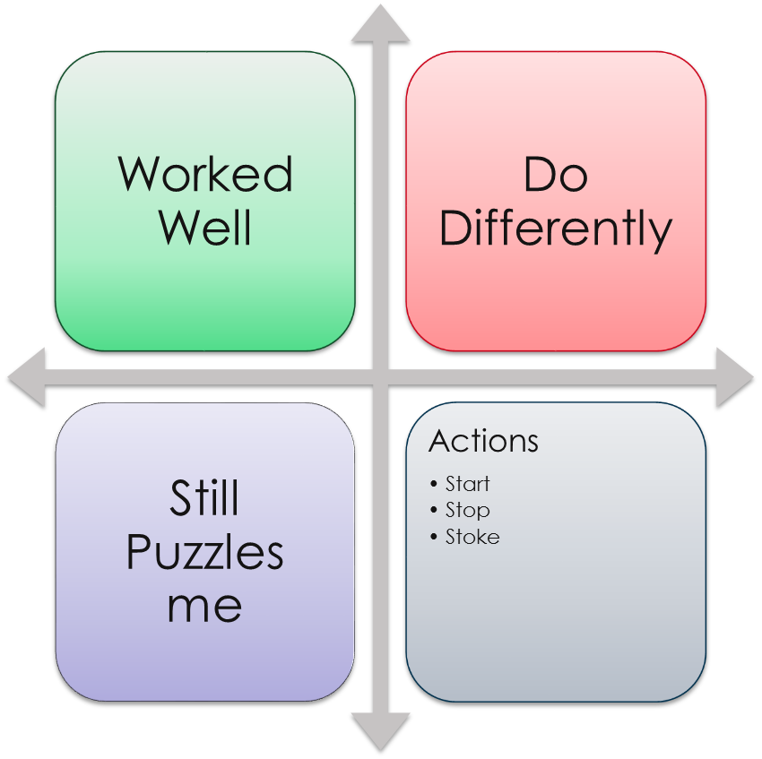
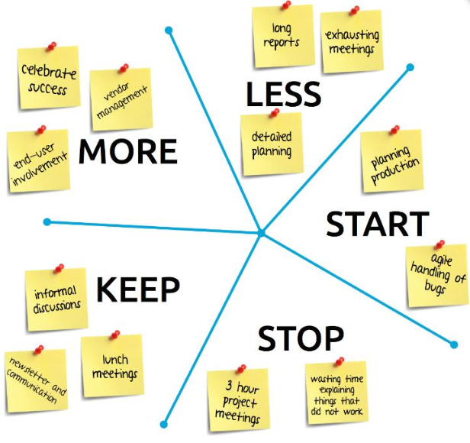
Gathering Methods
Notes:
Many different ways to conduct a retro.
Others include:
Pair Interviews
Timeline
Short Subjects
Mad/Sad/Glad
Stop/Start/Continue
Learning Matrix
Like to Like card game
The Orchestra Retrospective
The Soccer Retrospective
The Train Retrospective
The Kitchen Retrospective
The Pirate Retrospective

Slide 12
Generate Insights
Find things that went well and things that must be improved

Slide 13
Generate insights
What did we do well, that if we don’t discuss we might forget?
What did we learn?
What should we do differently next time?
What still puzzles us?
When were you excited to come to work?
When was coming to work “just a job”?
When did you dread coming to work?
What were the high points? What were the low points?
Why did these things happen?
Five Whys
Notes:
Explanation of the items raised during brainstorming followed by a group vote on the topics the team would like to discuss in more detail
Others include:
Mission Impossible
Brain-writing
Challenge Cards
Explore, interpret, analyse the data
Look for patterns and themes - think creatively
Creates shared memory
Observations not evaluations
Open up space to explore later
Five Whys
Force Field Analysis
Flip It
De Bono’s 6 Thinking Hats
Anti-problem
Pre-Mortem

Slide 14
Decide What To Do
Find actions to take and commit to executing them

Slide 15
Remember your Locus of Control
Harder to get movement here
External Locus of Control
Outcomes outside your control – determined by “fate” and independent of your hard work or decisions.
Things You
Cannot Influence
Things You Can
Influence But
Not Control
Raise these with other teams – but they might not do them
Things You
Can Control
Internal Locus of Control
Outcomes within your control – determined by your hard work, attributes, or decisions.
Actions are best here

Slide 16
Decide what to do
“Can ‘we’ achieve this?”
“What does success look like?”
“What’s the first step?”
“Who is going to own this?”
Notes:
Many teams skip this phase and immediately try to define future experiments without considering the possible causes of the current situation.
This means that they only ever scratch the surface and that their measures will only treat the symptoms instead of dealing with the root causes.
Do not try to tackle all of your problems at once. Instead, choose the issues that the group feels are the most important.
You won’t be able to solve all of your problems in a single retrospective.
Move toward conclusions
Focus on improvement
Prioritize
Dot voting
Absolute order
Identify 2-5 actions
Create actions that are a return on investment
Actions should be documented and created as backlog tasks to be addressed in upcoming iterations
Assign an owner and a due date
Ask:

Slide 17
Close The Retro
Wind up and say goodbye

Slide 18
Close the retrospective
Did we have the right people?
Were the activities useful?
Did we meet our goal for the retrospective?
THANK-YOU!!
Notes:
Retro of our retro
Ask:
Did we have the right people?
Were the activities useful?
Did we meet our goal for the retrospective?
Decide on when the next retrospective will be held
Thank everyone for their time

